Slide 1
Introduction to Pioneer 3-DX, ARIA and MobileSim

Slide 2

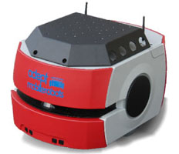
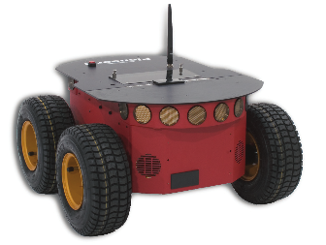
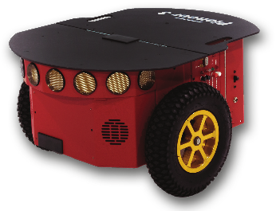
What is Pioneer
Pioneer is a family of mobile robots, including two-wheel and four-wheel drive versions.
http://www.mobilerobots.com/
Pioneer 3-AT
Pioneer 3-DX
Pioneer LX

Slide 3
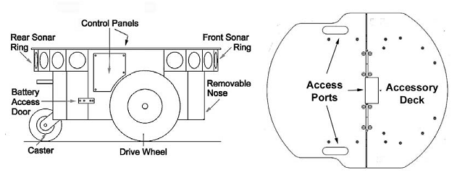
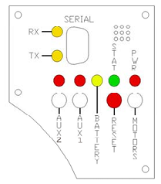
Pioneer 3-DX
Specifications
Side view
Top view
Control Panels

Slide 4
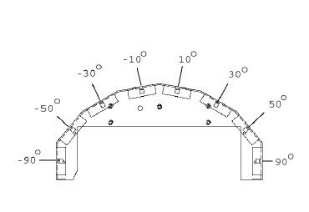
Pioneer 3-DX
Sonars
8 sonar arrays: One on each side, and six facing outward at 200 intervals
Range from 10cm to 5m
Sonar numbers
Front
2
3
4
5
1
6
0
Top
7

Slide 5
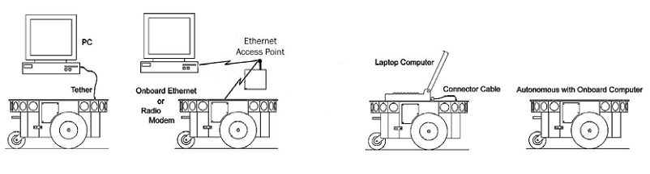
Connection Options
All MobileRobots platforms are served in a client-server architecture.

Slide 6
ARIA
Open-source C++ library for all MobileRobots platforms and many accessory devices.
Applications developed with ARIA can easily navigate the mobile platform, as well as manage odometry, sensor readings, and other operating data.
Download link: https://reurl.cc/W4dl2x
Recommended OS: Ubuntu 16.04

Slide 7
Examples of ARIA
Path
/usr/local/Aria/examples
Important examples
demo.cpp
General purpose testing and demo program, using ArMode classes to provide keyboard control of various robot functions.
wander.cpp
Example using actions and sonars to implement a random wander avoiding obstacles.

Slide 8
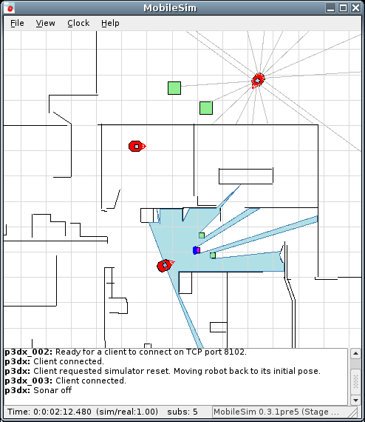
MobileSim
MobileSim provides a simulation environment for MobileRobots platforms and many accessories.
Download link: https://reurl.cc/Qpdzr5
The following pages show how to run MobileSim on Windows and Ubuntu.

Slide 9
Ubuntu
Download ARIA and MobileSim.
Latest Version for Ubuntu 16.04
ARIA 2.9.4
MobileSim 0.9.8
Install them with the file.
They should be located at:
/usr/local/Aria
/usr/local/MobileSim
Make ARIA before use it.

Slide 10
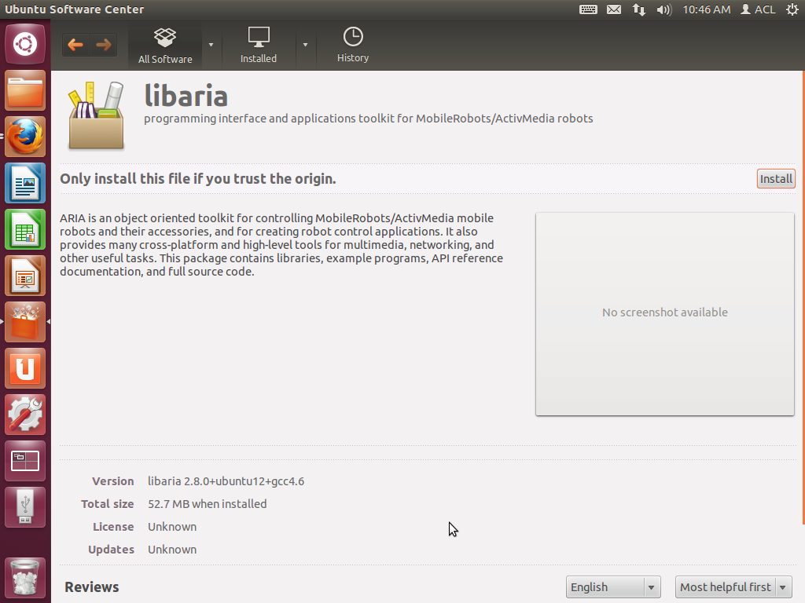
Ubuntu

Slide 11
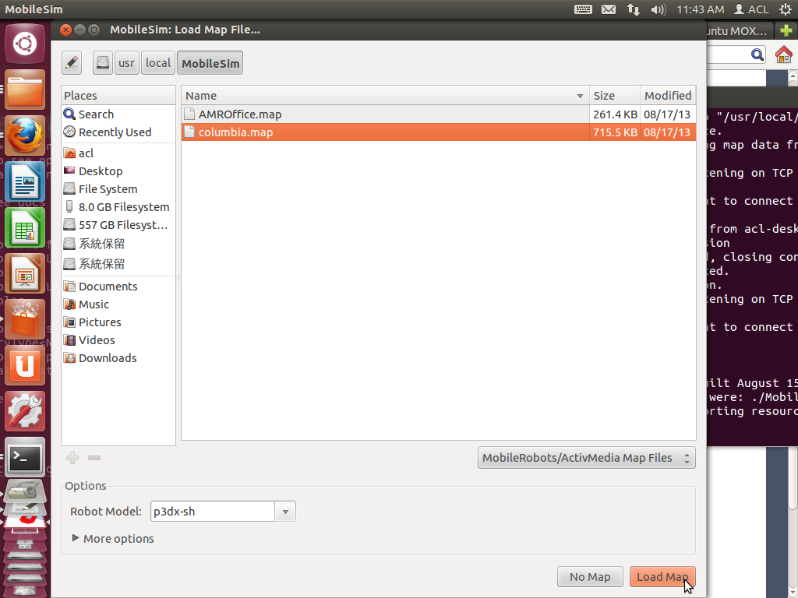
Ubuntu

Slide 12
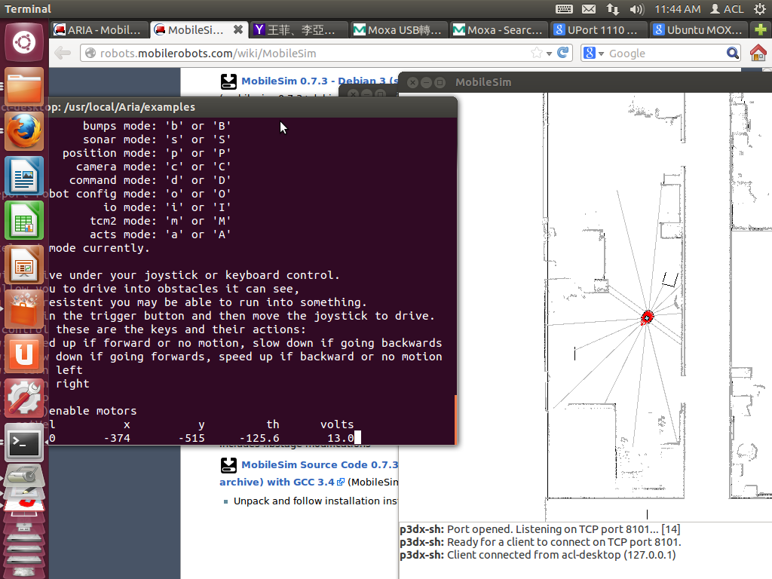
Ubuntu

Slide 13
Assignment1 Announcement
Assignment1 is now live on CEIBA.
Deadline: 2019/10/07 13:00
Make sure you followed the requirements before submission.

